Slide 1
CDBG Downtown Revitalization
December 2014 Update

Slide 5
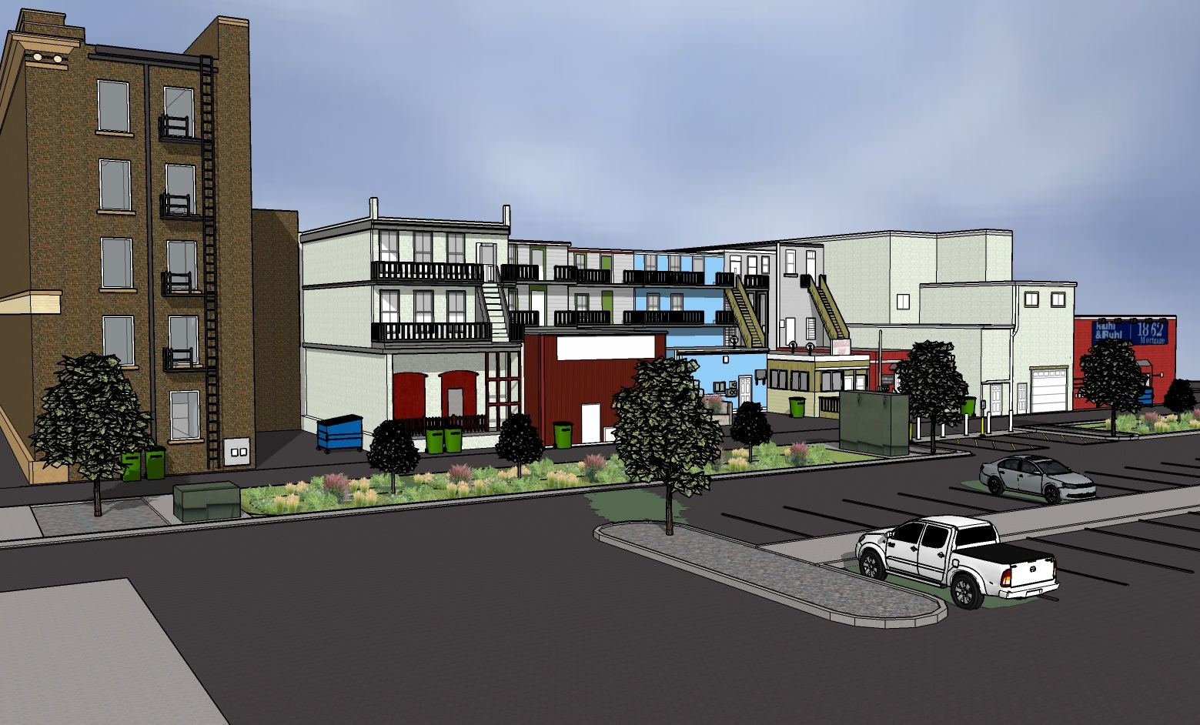

Slide 6
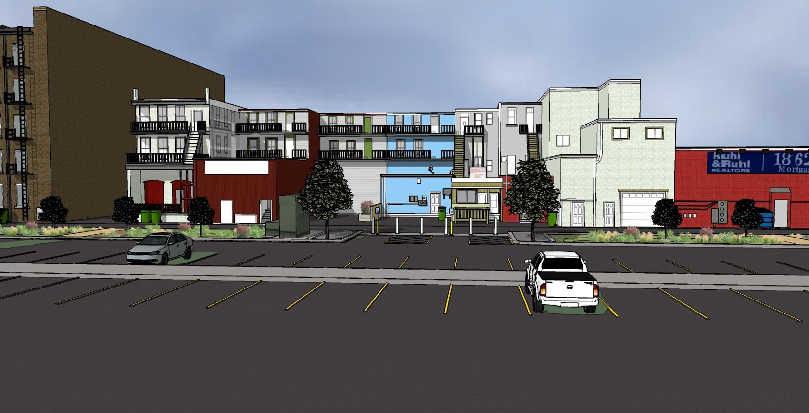

Slide 7
Project Update
Committing Property Owners
Schedule
  Property owners confirmed by January 23, 2015
  SHPO confirmation by February 27, 2015
  Out for bid in early March 2015
  Start construction end of March 2015
    Utilities, buildings, and lastly stormwater
  Project closeout December 2015

