Slide 1
E-Scooters and Possible City Code and Policy Changes to Enable their use in Muscatine
March 11, 2021

Slide 2
City Council Direction Needed
Council needs to now provide direction on how they wish City staff to proceed on this issue.
There are three basic options for how the City could proceed on this issue.
Implement a Scooter Rental Program in 2021
Implement a Scooter Rental Program in 2022
Take no action

Slide 3
Bird Proposal
At the January 14th in-depth City Council meeting, Bird a company which rents electric scooters in many communities nationwide, presented a request to offer electric scooter rental in Muscatine.
City Council directed City Staff to bring back more information regarding:
How City Code currently addresses this issue
Peer community experience with e-scooters
Potential benefits and risks of permitting e-scooter rental
What code and policy changes would be necessary to allow for what Bird is proposing
Notes:
Read slide

Slide 4
How Current City Code Regulates the Operations of e-Scooters
Operation of e-scooters on sidewalk is prohibited (City Code Section 7-2-8)
Operation of e-scooters on Trails is prohibited (City Code Section 3-5-8)
Parking of e-scooters on sidewalk is prohibited (City Code Section 7-7-4(C))
Parking of e-scooters on the public right of way between the sidewalk and curb is prohibited (City Code Section 7-7-4(T))
Notes:
Under current City Code, e-scooters are treated the same as any other motorized vehicles, meaning that they cannot be ridden on sidewalks or trails. Nor, can they be parked on sidewalks or in the right of way located between sidewalk and the back of the curb.

Slide 5
How Current City Code Regulates the Rental of e-Scooters
All for profit venture that make use of City Property or right of way, such as this proposal require prior approval of City Council. (City Code Section 5-12-1)
Notes:
AS with any other for profit venture that makes use of public property, such as this proposal for Bird. Specific prior approval from City Council is necessary.

Slide 6
Peer Community Experience
The type of e-scooter rental that Bird is proposing to bring to Muscatine has only existed since 2018.
Experience of communities with this type of e-scooter has varied greatly.
In general e-scooters have been more a positive experience in communities in which a regulatory and enforcement framework has been in place to mitigate the major negative impacts of e-scooter rental.
Notes:
The e-scooter rental service being proposed by Bird is a newer concept, first appeared in some larger metropolitan areas around 2018. Since the concept has spread rapidly to communities nationwide. The experience of these communities with this type of service appears to be quite varied. In general e-scooters have been more a positive experience in communities in which a regulatory and enforcement framework has been in place to mitigate the major negative impacts of e-scooter rental.

Slide 7
Peer Community Experience
A number of other Iowa communities have also in the past few months received proposals for e-scooter rental.
These communities include:
West Des Moines
Indianola
Bettendorf
Charles City
Algona
Keokuk
Fort Dodge
Notes:
Muscatine is not the only Iowa community currently examining a request to allow for e-scooter rental, these other communities appear to have received similar proposals at about the same time Muscatine.

Slide 8
Peer Community Experience
Ames – In March of 2020 the Ames city council voted down a proposed scooter rental program.
Des Moiens– Has been actively studying this issue since 2019.
Notes:
About a year ago, the Ames City Council rejected a proposal scooter rental program. The given rational for this rejection was the decision by Iowa State University to not allow for scooters on campus, and such the demand in the rest of the community would not support the proposed program
Des Moines has been actively studying this issue since 2019, with no decision yet made.

Slide 9
Peer Community Experience (Cedar Rapids)
Cedar Rapids is the only community Iowa to have an operating scooter renal program
Began as a limited pilot program in June 2019
Is part of and grew out of a bikeshare program, and is focused on the downtown and surrounding areas
Started with 30 scooters in 2019, grew to 70 scooters in 2020
During 2020 seasons, there was a total of 80,992 trips made on rented scooters
Notes:
Currently Cedar Rapids is the community in Iowa with operating e-scooter program similar to what Bird is proposing for Muscatine. The scooter rental program as a limited pilot program in June of 2019 starting with 30 scooters in 2019. The pilot program was determined to be a success and in 70 scooters in 2020 were operating, with a total of 80,992 trips being made in 2020. Cedar Rapids has announced that program will continue in the spring of 2020
In Cedar Rapids the program is focused on the downtown and surrounding areas, and is paired with a bikeshare program.
It began as a limited pilot program in 2019 with 30 scooter

Slide 10
Peer Community Experience (Cedar Rapids)
The City of Cedar Rapids and key stakeholders collaboratively identified 90 locations with the core of Cedar Rapids from which rented scooters can be picked up from and returned to.
Areas in which scooters would not be permitted to operate on the sidewalks were also identified.
Developed a signage and in-app message scheme to convey these restrictions to scooter users.
Notes:
Read slide

Slide 11
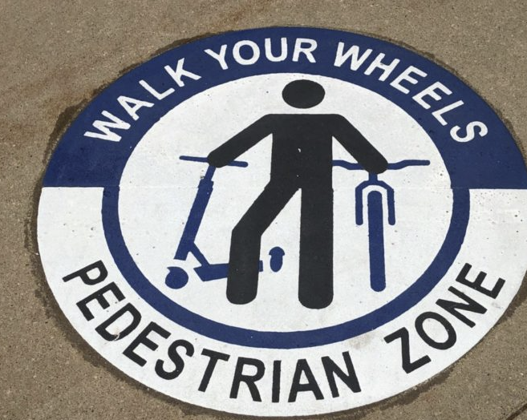
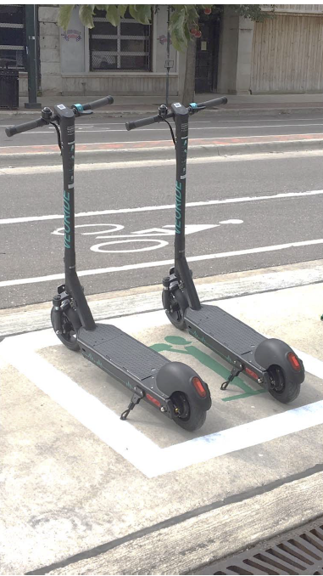
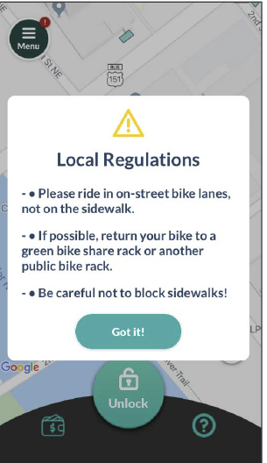
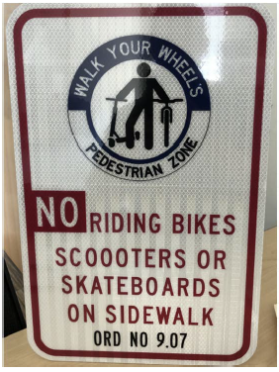
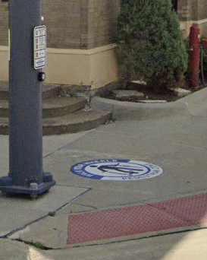
Peer Community Experience (Cedar Rapids)
Notes:
The three images to right give examples of the extensive signage installed around the portions of Cedar Rapdis in which scooters can operated. One of the 90 designated spots in which rented scooter are to be picked up or returned too. An image of the in app message that users get.

Slide 12
Potential Risks & Benefits (Benefits)
Creates another transportation option, potentially addressing some unmet needs
A recreational amenity
An additional way for residents and visitors to experience the trail network, should the decision be made to allow e-scooters on trails

Slide 13
Potential Risks & Benefits (Risks)
Safety of the rider interacting with the public is a primary concern.
A recently completed study by the Insurance Institute for Highway Safety, Highway Loss Data Institute found:
Of all studied individuals who were injured on an e-scooter, 33% suffered this injury on their first ride. Overall, 63% of the injured riders had ridden an e-scooter nine times or fewer before injury.
E-scooter riders suffered injuries more frequently per mile traveled than bicyclists, but bicyclists were 3 times as likely as scooter riders to be hit by motor vehicles.
Notes:
Study completed in October.

Slide 14
Potential Risks & Benefits (Risks)
A recently completed study by the Insurance Institute for Highway Safety, Highway Loss Data Institute found:
E-scooter riders were twice as likely as bicyclists to get injured because of a pothole or crack in the pavement or other infrastructure like a signpost or curb.
Nearly 3 out of 5 e-scooter riders were injured riding on the sidewalk — and about a third of these riders got those injuries in places where sidewalk riding is prohibited.
1 out of 5 was injured riding in the bike lane, multiuse trail or other off-road location.

Slide 15
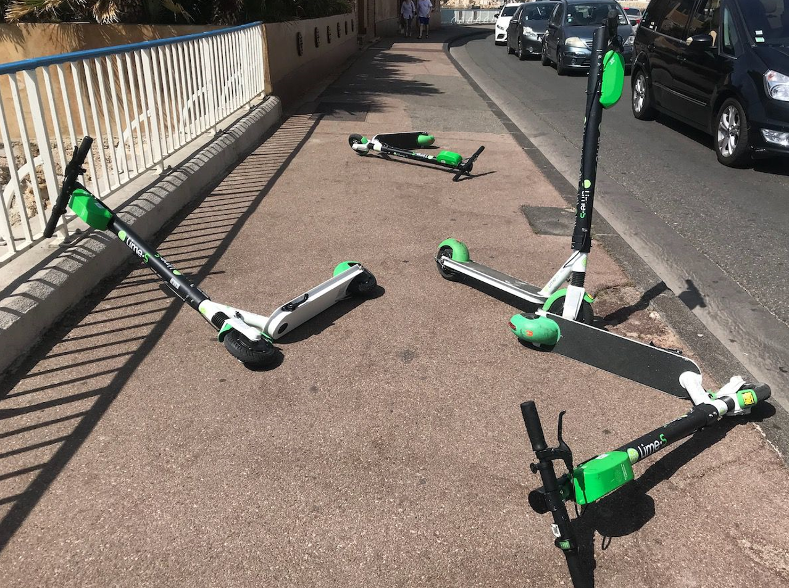
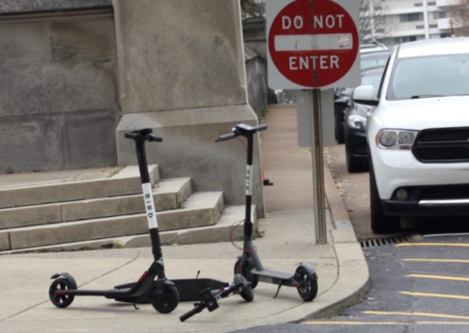
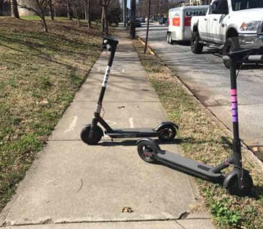
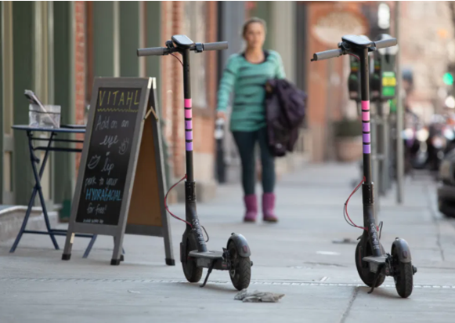
Potential Risks & Benefits (Risks)
Where scooters get left after a particular user finishes using one. In many cities’ scooters have been left in the middle of sidewalks, bike paths, parking ramps, creating trip hazards, blocking access, and impeding mobility.

Slide 16
Potential Risks & Benefits (Risks)
The amount of City resources and staff time that would be needed to ensure that e-scooters are safely ridden and parked.

Slide 17
Public Input
General public input
Stakeholder identification and consultation:
Downtown community
Parks and Recreation Advisory Commission
Muscatine Community College
Muscatine Chamber of Commerce and Industry

Slide 18
Policy Questions Regarding Scooter Operation and Rental (Permitting)
Process
Fees
Required insurance and indemnification
Identification of City Department responsible for administering

Slide 19
Policy Questions Regarding Scooter Operation and Rental (Operating Rules)
Speed limit
Minimum age requirement for operator
Rules for or prohibiting operation on sidewalks
Rules for or prohibiting operation on trails
Rules for operation on streets
Rules for parking and deployment of scooters

Slide 20
Policy Questions Regarding Scooter Operation and Rental (Enforcement)
Penalties for violation of scooter operation rules
Penalties for and procedures dealing with parking of scooters in prohibited locations

Slide 21
City Council Direction on Next Steps
Council needs to now provide direction on how they wish City staff to proceed on this issue.
There are three basic options for how the City could proceed on this issue.
Implement a Scooter Rental Program in 2021
Implement a Scooter Rental Program in 2022
Take no action

Slide 22
City Council Direction on Next Steps (Implement a Scooter Rental Program in 2021)
Would require specific council direction on the policy questions highlighted earlier in this presentation, Council direction would have to happen at the April in depth meeting.
A scooter rental program could then no sooner than July.
This aggressive schedule would require making this a top in priority in the allocation of staff time.
This option would create an abbreviated window for community and stakeholder input and a a short window of time between council approval and scooters arriving on the streets of Muscatine

Slide 23
City Council Direction on Next Steps (Implement a Scooter Rental Program in 2022)
Final action City Code changes would occur by the end of 2021
Spring and Summer of 2021
Outreach to gather community input
Identification of and consultation with stakeholders
Further research into to lessons learned in and best practices
Fall of 2021
Development of necessary code and policy changes
Public input and review of proposed changes
Council action on code
Fall of 2021
Installation of regulatory and informational signage
Community education and awareness campaign
Site specific planning for the daily deployment of rental scooters

Slide 24
City Council Direction on Next Steps (Take no action)
Leave City Code as is.
The scooter rental model proposed by Bird would not be viable under this option.

Slide 25
Staff Recommendation
Leave City Code as is and continue to monitor situation
Develop a pilot program, with extensive public and stakeholder input, with a targeted start date of 2022 or later

Slide 26
Staff Recommendation

